Slide 1
OLAP Operations & Data Models
DMBI

Slide 2
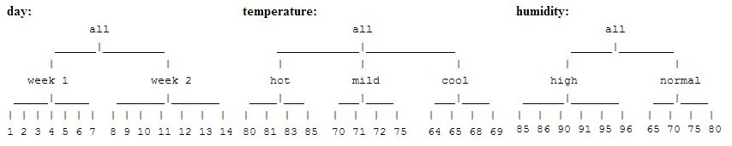
CONCEPT HIERARCHIES
For example, we have attributes as day, temperature and humidity, we can group values in subsets and name these subsets, thus obtaining a set of hierarchies as shown in figure below.
Notes:
In the multidimensional model, data are organized into multiple dimensions, and each dimension contains multiple levels of abstraction defined by concept hierarchies. This organization provides users with the flexibility to view data from different perspectives.
2

Slide 3
OLAP OPERATIONS
The most popular end user operations on dimensional data are:
Roll up
Roll Down
Slicing
Dicing
Pivot
Notes:
OLAP provides a user-friendly environment for interactive data analysis. A number of OLAP data cube operations exist to materialize different views of data, allowing interactive querying and analysis of the data.
3

Slide 4
Roll up(1)
The roll-up operation (also called drill-up or aggregation operation) performs aggregation on a data cube, either by climbing up a concept hierarchy for a dimension or by climbing down a concept hierarchy, i.e. dimension reduction. Here cube illustrating temperature of certain days recorded weekly

Slide 5

Roll up(2)
Assume we want to set up levels (hot(80-85), mild(70-75), cold(64-69)) in temperature from the above cube. To do this we have to group columns and add up the values according to the concept hierarchy. This operation is called roll-up. By doing this we obtain the following cube:
The concept hierarchy can be defined as hot-->day-->week. The roll-up operation groups the data by levels of temperature.

Slide 6
Roll Down (1)
The roll down operation (also called drill down) is the reverse of roll up. It navigates from less detailed data to more detailed data.
It can be realized by either stepping down a concept hierarchy for a dimension or introducing additional dimensions.
Performing roll down operation on the same cube mentioned above:

Slide 7
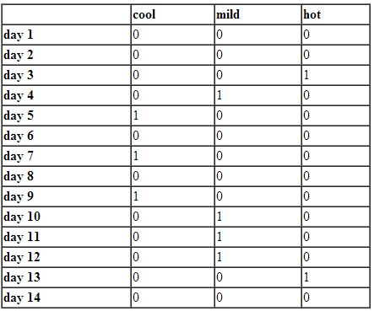
Roll Down(2)

Slide 8
Roll Down(3)
The result of a drill-down operation performed on the central cube by stepping down a concept hierarchy for temperature can be defined as day<--week<--cool.
Drill-down occurs by descending the time hierarchy from the level of week to the more detailed level of day. Also new dimensions can be added to the cube, because drill-down adds more detail to the given data.

Slide 9
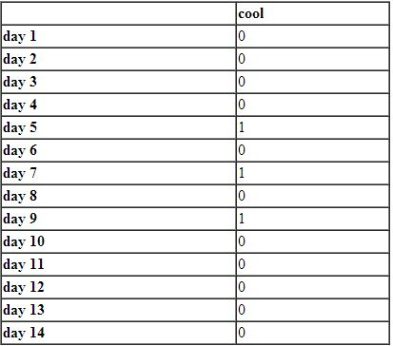
Slicing
Slice performs a selection on one dimension of the given cube, thus resulting in a subcube. For example, in the cube example above, if we make the selection, temperature=cool we will obtain the following cube:

Slide 10

Dicing
The dice operation defines a sub cube by performing a selection on two or more dimensions. For example, applying the selection (time = day 3 OR time = day 4) AND (temperature = cool OR temperature = hot) to the original cube we get the following sub cube (still two-dimensional):

Slide 11
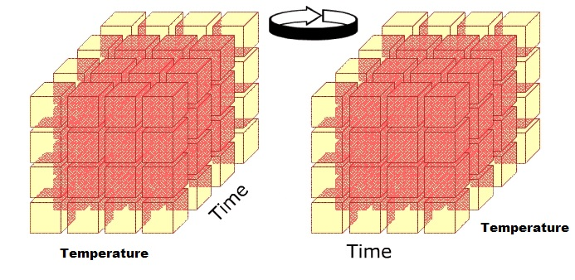
Pivot
Pivot otherwise known as Rotate changes the dimensional orientation of the cube, i.e. rotates the data axes to view the data from different perspectives. Pivot groups data with different dimensions. The below cubes shows 2D representation of Pivot.

Slide 12
Other OLAP operations
DRILL ACROSS: Accesses more than one fact table that is linked by common dimensions. Combines cubes that share one or more dimensions.
DRILL THROUGH: Drill down to the bottom level of a data cube down to its back end relational tables.

Slide 13
Summary
Concept hierarchies organize the values of attributes or dimensions into abstraction levels. They are useful in mining at multiple abstraction levels.
Typical OLAP operations include roll-up, and drill-( down, across, through), slice-and-dice, and pivot ( rotate), as well as some statistical operations.
OLAP operations can be implemented efficiently using the data cube structure.

Slide 14
EXAMPLES OF OLAP OPERATIONS
we are going to use a movie and awards data mart as an example to illustrate the OLAP operations. The data mart contains the following dimension tables and fact table.
DIMENSION TABLES
Year
Movie
Awards
Award categories
Winners(names)
FACT TABLE
AwardCollectionFact

Slide 15
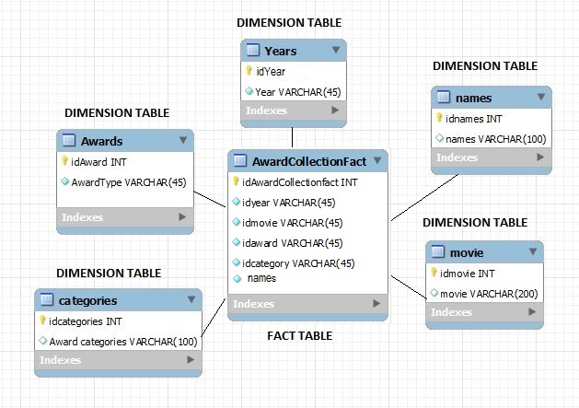
STAR SCHEMA

Slide 16
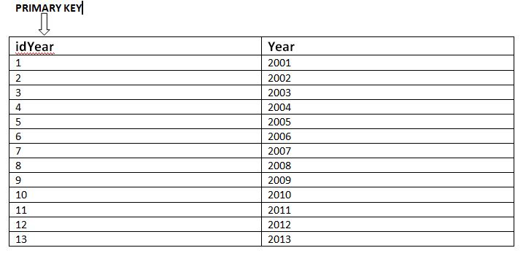
DIMENSION TABLES: YEAR

Slide 17
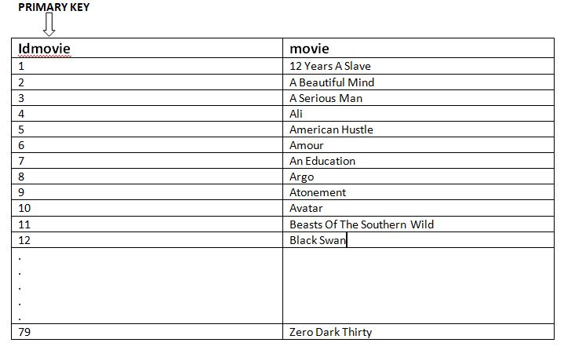
DIMENSION TABLES: MOVIE

Slide 18
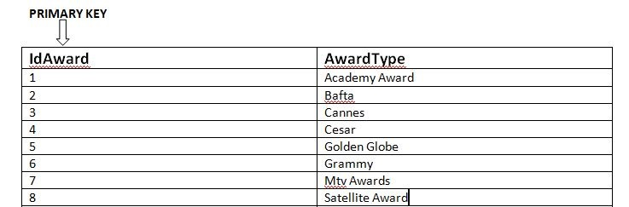
DIMENSION TABLES: AWARDS

Slide 19
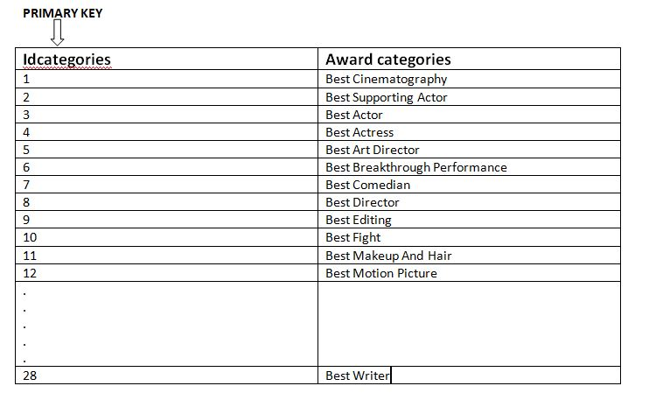
DIMENSION TABLES: Award categories

Slide 20
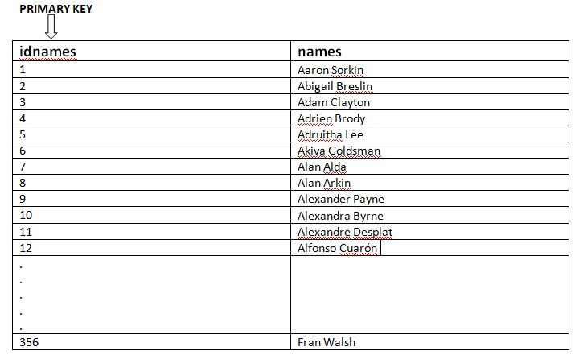
DIMENSION TABLES: WINNERS (NAME)

Slide 21
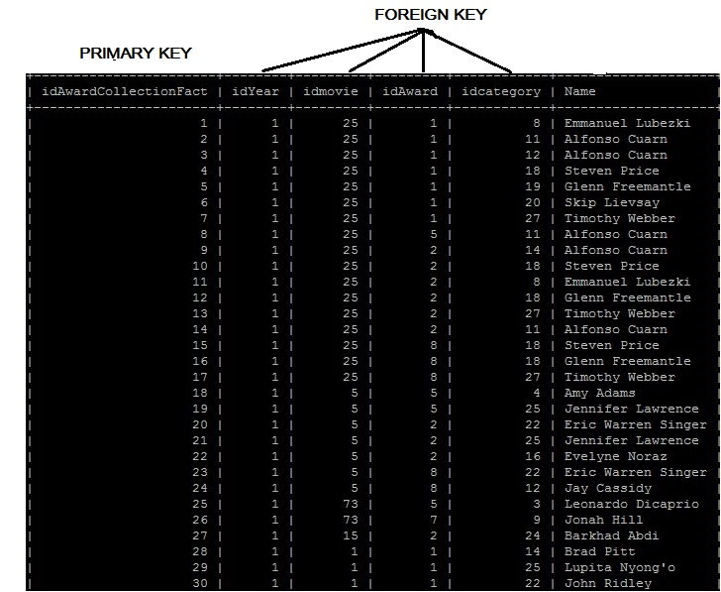
FACT TABLE: AwardCollectionFact

Slide 22
Exercise
Create a schema(database) with fact and dimension tables from the above excel sheet.
Perform the following OLAP operations on your schema.
ROLLUP
ROLLDOWN
SLICING
DICING

Slide 23
DATA MODELS IN THE OLAP WORLD
Cubes can be stored in three different models: Relational OLAP (ROLAP) Multidimensional OLAP (MOLAP) Hybrid OLAP (HOLAP)

Slide 24
ROLAP
To provide fast response time to OLAP applications, super relational features are added to traditional RDBMS to form super relational database systems. The data in this model is stored in relational databases.
Relational OLAP follows dimensional modeling, which organizes data into measures stored in fact tables and dimensions stored in dimension/satellite tables.
ROLAP uses data marts. Data marts are databases that share many of the features of data warehouses but are smaller in scope.
Data can be stored in two ways in a relational model:
Star Schema
Snow flake Schema

Slide 25
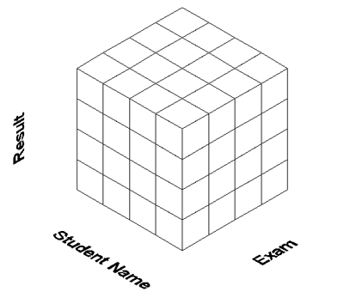
MOLAP
MOLAP is a special purpose data model in which multidimensional data and operations are mapped directly. The data is presented to the user in such a way as to represent a hypercube, or multi-dimensional array, where each individual data value is contained within a cell accessible by multiple indexes.
This database contains three dimensions: Result, Student Name and Exam.
Notes:
Results of a student can be compared over a period of time, for example a four-year undergraduate course. Also, more dimensions can be added until all requirements are met. This model represents a higher level of organization, and an intelligent view of the data.
25

Slide 26
HOLAP
HOLAP is a combination of ROLAP and MOLAP. HOLAP allows storing part of the data in a MOLAP store and another part of the data in a ROLAP store, allowing a tradeoff of the advantages of each.

Slide 27
APPLICATION ORIENTED OLAP
Reporting and querying for standard controlling tasks
Problem and opportunity analysis(business intelligence)
Planning applications
One of a kind data mining campaigns or analysis projects

Slide 28
Summary
OLAP is flexible, and provides summarized and multidimensional view of data.
In ROLAP data are stored in relational databases and in MOLAP data is stored in multidimensional cubes.
Application oriented OLAP tends to be subject oriented and requires historical data.

